Slide 1
BIOLOGICAL AND CULTURAL EVOLUTION

Slide 2
BIOLOGICAL EVOLUTION
It refers to the changes , modifications, and variations in the genetics and inherited traits of biological populations from one generation to another.

Slide 3
CULTURAL /SOCIOCULTURAL EVOLUTION
It refers to the changes or development in cultures from a simple form to a more complex form of human culture.
It happens as a result of human adaptation to different factors like climatic changes and population increase.

Slide 4
CHARLES DARWIN (1809-1882)
He was a British naturalist who proposed the theory of biological evolution by natural selection.
Darwin defined evolution as “descent with modification,” the idea that species change over time, give rise to new species, and share a common ancestor.

Slide 5
NATURAL SELECTION
Because resources are limited in nature, organisms with heritable traits that favor survival and reproduction will tend to lead more offspring than their peers, causing the traits to increase in frequency over generations.

Slide 6
Natural selection causes populations to become adapted, or increasingly well-suited to their environments over time. Natural selection depends on the environment and requires existing heritable variation in a group.

Slide 7
FROM HOMINIDS TO HOMO SAPIENS SAPIENS

Slide 8
FOSSILS
It refer to the human, plant, and animal remains that have been preserved through time like human or animal teeth, skull and bone fragments.

Slide 9
ARTIFACTS
It refer to the objects that were made and used by humans.
Examples of artifacts include stone tools, metal tools, ceramics, earthenware, burial jars and ornaments.

Slide 10
HOMINID
It is the general term used by scientists to categorize the group of early humans and other humanlike creatures that can walk erect during the prehistoric times.

Slide 11
Four categories of hominids
Sahelanthropus
Ardipithecus
Australopithecus
Homo

Slide 12
Sahelanthropus tchadensis
The first hominid came from its lineage
Lived sometime between 6-7 million years ago in West-Central Africa
It had both apelike and humanlike characteristics
A skull similar to the Australopithecus and modern human
Height almost similar with the chimpanzee
Brain size of about 320-380 cubic centimeters
Small teeth similar to other hominids
Had the ability to walk upright

Slide 13
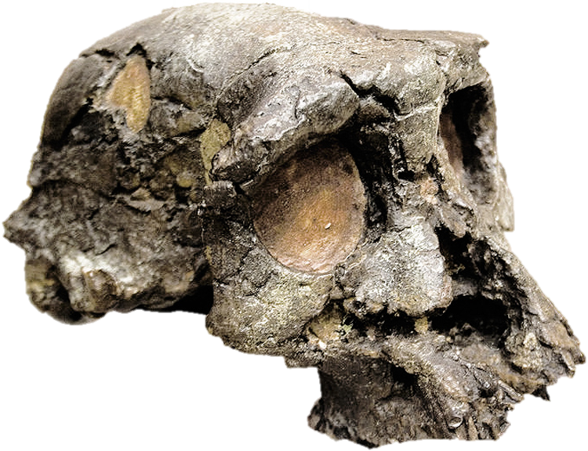
Sahelanthropus tchadensis

Slide 14
Orrorin tugenensis
Lived sometime between 6.2 and 5.8 million years ago
Approximately the size of a chimpanzee
Had small teeth with thick enamel, similar to modern humans.
The most important fossil of this species is an upper femur, showing evidence of bone buildup typical of a biped - so Orrorin tugenensis individuals climbed trees but also probably walked upright with two legs on the ground.
Notes:
Original man

Slide 16
Ardipithecus
Two species
Ardipithecus kadabba (5.6 mya)
Ardipithecus ramidus (4.4 mya)

Slide 17
Characteristics
Height of about 4 feet
Weight of about 120 pounds
Skull size similar to an ape
Small brain
Biped
Lived in jungles and forests like chimpanzees

Slide 19
Australopithecus or “southern ape”
Lived in the African jungle from 5 to 1 mya
Brain size of 500 cc or almost 1/3 of the size of the modern human brain
Upright
Biped
Tool users and not tool makers
Used sticks and stones for digging
Lived in small social groups
Distance of movement was estimated to be 15 km or more to search for stones to be used as tools
Food scavengers
Ate insects, eggs, plants, fruits and sometimes meat

Slide 20
There are six species of the Australopithecus and they are divided into two major categories: the gracile and the robust
Gracile Australopithecus had small teeth and jaw
Australopithecus anamensis
Australopithecus afarensis
Australopithecus africanus

Slide 21
Robust Australopithecus
Australopithecus aethiopicus
Australopithecus robustus
Australopithecus boisei
They had large teeth and jaws and muscular built

Slide 22
Australopithecus afarensis
Considered as the common ancestor of the Australopithecus species
The 3.2 mya old Australopithecus afarensis fossil named “Lucy” was considered as one of modern human’s earliest ancestors
Remains as the most famous hominid fossil discovered

Slide 23
The Homo are classified as humans and not humanlike creatures because they had bigger brains and were bipedal.
The Homo first lived in Africa about 2.4 million years ago.
The Homo species included the Homo habilis (handy man), Homo erectus (upright man), and the Homo sapiens

Slide 24
Homo habilis
Height of about 3 to 4 feet
Brain size half the size of the modern human (700 cc)
Made tools called Oldowan (Olduvai Gorge, Tanzania) which were used as cutting tools and made from volcanic stones
Used tools for hunting and food gathering
Notes:
Ancestor of the modern human because of its ability to produce tools

Slide 28
Homo ergaster/Homo erectus
Homo ergaster (1.8 mya), it was from this species where Homo erectus came from
Homo erectus was estimated to live from 1.8 million to 300,000 years ago
Brain size of 1,000 cc or about 2/3 of the modern human brain size
Height of about five feet
Walks upright

Slide 29
Cultural development
More intelligent and more adaptable compared to Homo habilis
Known for making complex tools used for digging, cutting and scraping
Famous for making and using hand axe tools for slicing, chopping and digging
Skillful hunters
First Homo species to use fire and live in caves and small houses made of tree branches
Able to live in cold and dark places like caves
Cook food and meat
Notes:
Manifested cultural evolution because they used their intelligence to invent and develop different technologies to respond to their needs

Slide 30
Homo erectus was the first Homo to use spoken language.
The Homo erectus fossil was first discovered in Africa
They started to travel outside of the African continent, reached as far as Asia and Southern Europe.
First fossil of the Homo erectus in Asia was found in Longgupo Cave in China lived around (1.9 mya)

Slide 31
Another fossil was excavated in Trinil, Java, Indonesia by Eugene Dubois (1848-1940), a Dutch anatomist and geologist, in 1811.
The fossil became known as the Java Man and it was dated to be 1.8 million years of age.
In 1920, another Homo erectus skull was excavated in a cave in Zhoukoudian, China.
This became known as the Peking Man.
It was estimated to have lived about 1.1 million to 1 million years ago.

Slide 32
Homo sapiens
Last genus of the evolution ladder
Homo sapiens
Homo heidelbergensis
Homo neanderthalensis
Homo sapiens sapiens

