Slide 2
Let’s play!!!!

Slide 3
GREAIMAR
MARRIAGE

Slide 4
IPKNSIH
KINSHIP

Slide 5
DOBLO
BLOOD

Slide 6
GNIELAE
LINEAGE

Slide 7
CDESNTE
DESCENT

Slide 8
TPARCIHRA
PATRIARCH

Slide 9
GOMAONYM
MONOGAMY

Slide 10
KINSHIP

Slide 11
KINSHIP
It is a social institution that refers to relations formed between members of society.
It explains the nature and reason for the formation of the different types of bonds that exist within society.

Slide 12
KINSHIP
Sociologists define it as the different forms of socially accepted relations among people developed through blood or consanguineal relationships, marriage or affinal relationships, adoption, and other culturally accepted rituals.

Slide 13
TYPES OF KINSHIP
SOCIETIES DEVELOP KIN RELATIONSHIPS IN DIFFERENT WAYS. IT CAN BE BASED ON BIRTH OR BLOOD RELATIONS, MARRIAGE, OR THROUGH THE ACCEPTANCE OF RITUALS.

Slide 14
KINSHIP BY BLOOD
Consanguineal kinship or kinship based on blood is considered as the most basic and general forms of relations. The relationship is achieved by birth or blood affinity.
The relationship existing between parents and their children, between siblings, and between nieces/nephews and aunts/uncles are example of this type of kinship.

Slide 15
DESCENT
It refers to a biological relationship.
Societies recognize that children descend from parents and that there exists a biological relationship between parents and their offspring.
Descent also often refers to an individual’s child or offspring or his/her parents ancestry.
Notes:
In the study of consanguineal kinship, descent is an important key concept.

Slide 16
LINEAGE
It refers to the line where one’s descent is traced. An individual’s descent can be traced by studying either the person’s paternal or maternal line or both the father’s and the mother’s line.

Slide 17
PRINCIPLES OF DESCENT
Notes:
Kinship can be studied by analyzing the relationships that exist between persons. Anthropologists develop diagrams to clearly explain and illustrate the different consanguineal relationships.

Slide 18
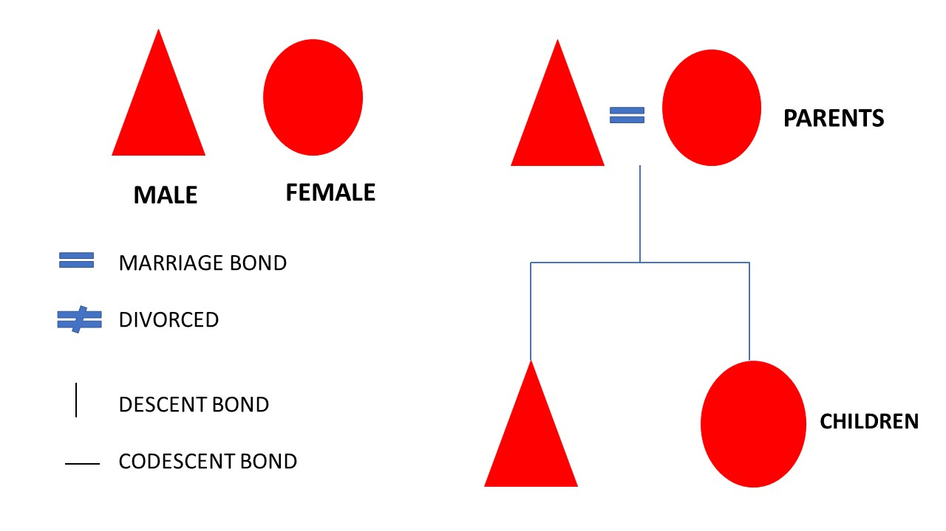

Slide 19
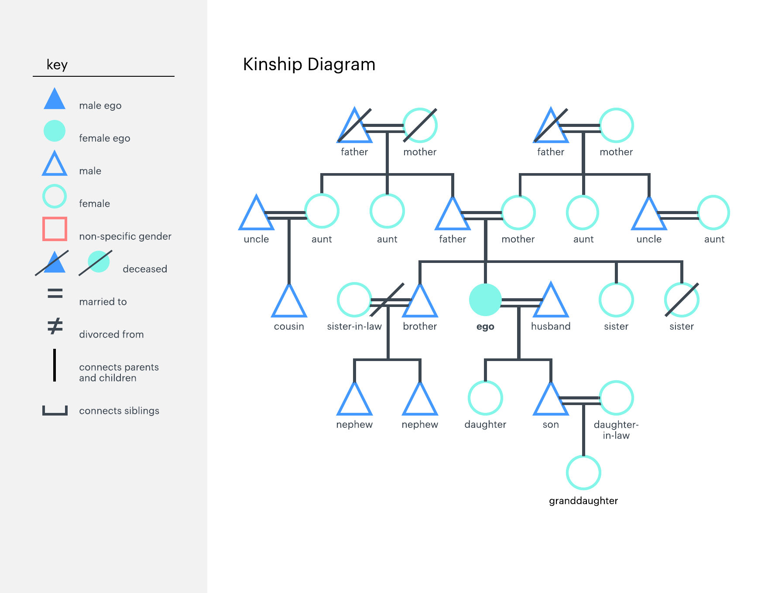
Notes:
Ego refers to a person to whom kinship relationships are referred to and has no specific gender

Slide 20
UNILINEAL DESCENT
Descent is usually traced by most societies through a single line of ancestors from either the male and female line. This is called the unilineal descent principle.

Slide 21
In this principle, both males and females are members of unilineal family but their descent lines are recognized only through the relatives of either the male or female member.
Unilineal descent have two basic forms, namely, patrilineal and matrilineal.
Notes:
As the name 'unilineal' implies, with 'uni' meaning 'one' as in 'unicycle,' unilineal descent is a kinship, or family system, in which descent is traced through only one gender. To sort of oversimplify it, it's a family tree that is only tracked through the men or the women of the family but not both.

Slide 22
PATRILINEAL DESCENT
Under this form, both males and females belong to the kin group of their father but they do not belong to their mother’s kin group.
In this form of descent, only the males pass on to their children their family identity. A woman’s children are members of her husband’s patrilineal line.

Slide 24
MATRILINEAL DESCENT
It focuses on the unilineal descent that is traced through the female line.
Matrilineal society, also called matriliny, group adhering to a kinship system in which ancestral descent is traced through maternal instead of paternal lines

Slide 26
Matrilineal societies are found in various places around the world, such as in parts of Africa, Southeast Asia, and India.
Specific cultural practices differ significantly among such groups. Though there are similarities, matrilineal practices in Africa differ from those in Asia, and there are even differences in such practices within specific regions.

Slide 27
The Asante, or Ashanti, of Ghana are one of the few matrilineal societies in West Africa in which women inherit status and property directly from their mothers.
The Minangkabau of Sumatra, Indonesia, are the world’s largest matrilineal society, in which properties such as land and houses are inherited through female lineage. In Minangkabau society, the man traditionally marries into his wife’s household, and the woman inherits the ancestral home.

Slide 28
Among those groups, the main difference is observed in matrilocal, duolocal, and neolocal residence patterns.
The pattern of duolocal residence (the husband and wife occupy different homes) exists among the Asante, the Minangkabau, and the Nayar.
The Khasi generally follow the matrilocal residence pattern (the husband moves in with his wife’s matrilineal kin)
neolocal residence pattern (the couple sets up home in a new residence in or around the wife’s maternal residence).

Slide 29
BILATERAL DESCENT
This is called as the nonunilineal or cognatic descent principle. There are different forms of nonunilineal descent principles, but the most common form of nonunilineal descent is the bilateral descent.
In a bilateral descent, kinship is traced through both ancestral lines of the mother and father.
Notes:
Some societies trace their descent through the study of both parents’ ancestors.

Slide 30
KINSHIP BY MARRIAGE
Affinal kinship or kinship based on marriage refers to the type of relations developed when a marriage occurs.

Slide 31
Article 1 of the Family Code of the Philippines
Marriage is a special contract of permanent union between a man and a woman entered into in accordance with law for the establishment of conjugal and family life. It is the foundation of the family and an inviolable social institution whose nature, consequences, and incidents are governed by law and not subject to stipulation, except that marriage settlements may fix the property relations during the marriage within the limits provided by this Code.

Slide 32
MARRIAGE ACROSS CULTURE

Slide 33
ENDOGAMY
Endogamy is also called in-marriage and is the custom of marrying within one's cultural group or clan.
This requirement was created to keep health, culture, and ethnicity within cultural groups.
Historically, endogamy has been associated with aristocracy, religious groups, ethnic groups, and social classes.

Slide 34
EXOGAMY
Exogamy is when a person marries outside of their social group or class. Within some of the royal/historically known families, the practices of endogamy or exogamy can be seen.

Slide 36
MONOGAMY
Monogamy came from the Greek words monos and gamos which literally mean “one union”. It refers to the marriage or sexual partnering custom or practice where an individual has only one male or female partner.

Slide 37
POLYGAMY
It refers to the practice of having more than one partner.
It can be polygyny – a man has multiple female partners or polyandry – a woman has multiple male partners

Slide 38
POSTMARITAL RESIDENCY RULES

Slide 39
PATRILOCAL
It occurs when married couples stay in the house of the husband’s relatives or near the husband’s kin.

Slide 40
MATRILOCAL
It happens when the couples live with the wife’s relatives or near the wife’s skin

Slide 41
BIOLOCAL
It happens when the newlywed couple stay with the husband’s relatives and the wife’s kin alternately.

Slide 42
NEOLOCAL
The couple settle independently and build a home that is independent from the place of residence of both of the newlywed’s parents.

Slide 43
KINSHIP BY RITUALS

Slide 44
COMPADRAZGO
It is literally translated as “godparenthood’, is a ritualized form of forging co-parenthood or family.
Originating in the medieval Catholic church in Europe, this can be done through the performance of Catholic rituals like baptism, confirmation and marriage.
These people who were chosen by the biological parents to act as witnesses during baptism, confirmation or marriage, become the spiritual parents of the child.

