Slide 1
THE COMPLEXITY OF CULTURE

Slide 2
CULTURE DEFINED
It is a people’s way of life.
E.B Taylor describes culture as “that complex whole, which encompasses beliefs, practices, values, attitudes, laws, norms, artifacts, symbols, knowledge, and everything that a person learns and shares as a member of society.”

Slide 3
ASPECTS OF CULTURE

Slide 4
NONMATERIAL CULTURE
values
beliefs
norms
mores
symbols
language

Slide 5
MATERIAL CULTURE
tools and technology
clothing
eating utensils
means of transportation

Slide 6
CHARACTERISTICS OF CULTURE

Slide 7
CULTURE IS LEARNED
It is not biological; we do not inherit it. Much of learning culture is unconscious. We learn culture from families, peers, institutions, and media. The process of learning culture is known as enculturation. While all humans have basic biological needs such as food, sleep, and sex, the way we fulfill those needs varies cross-culturally.

Slide 8
CULTURE IS SHARED
Culture is not something that an individual alone can possess. Culture in sociological sense, is shared.
The patterns of learned behavior and the results of behavior are possessed not by one or a few persons, but usually by a large group.
Because we share culture with other members of our group, we are able to act in socially appropriate ways as well as predict how others will act.
Notes:
Because we share culture with other members of our group, we are able to act in socially appropriate ways as well as predict how others will act. Despite the shared nature of culture, that doesn’t mean that culture is homogenous (the same).

Slide 9
CULTURE IS BASED ON SYMBOLS
A symbol is something that stands for something else. Symbols vary cross-culturally and are arbitrary. They only have meaning when people in a culture agree on their use. Language, money and art are all symbols. Language is the most important symbolic component of culture.

Slide 11
CULTURE IS INTEGRATED
This is known as holism, or the various parts of a culture being interconnected. All aspects of a culture are related to one another and to truly understand a culture, one must learn about all of its parts, not only a few.

Slide 12
CULTURE IS DYNAMIC
This simply means that cultures interact and change. Because most cultures are in contact with other cultures, they exchange ideas and symbols. All cultures change, otherwise, they would have problems adapting to changing environments. And because cultures are integrated, if one component in the system changes, it is likely that the entire system must adjust.

Slide 13
ETHNOCENTRISM

Slide 14
The world ethno comes from the Greek and it refers to a people, nation, or cultural grouping.
Centric, comes from Latin refers to the “center”.
It is a term coined by William Graham Sumner.

Slide 15
It refers to the tendency of each society to place its own culture patterns at the center of things.
The practice of comparing other cultural practices with those of one’s own and automatically finding those other cultural practices to be inferior.
It is the belief that your native culture is the most natural or superior way of understanding the world.
Notes:
It is a universal human reaction found in all known societies in all groups.

Slide 16
WHEN DO WE BECOME ETHNOCENTRIC AND WHAT IS OUR WAY OUT?

Slide 17
1. When you judge the behavior and beliefs of people who are different from you.
WAY OUT:
To stop ethnocentric behavior, you must stop judging others who are different from you.
Notes:
Believing that one’s own ways are the best encourages a “we” feeling

Slide 18
2. When you believe that there are primitive cultures, especially if their way of life is different from yours.
WAY OUT:
Ethnocentrism is taught. You have to unlearn that your culture is superior and all other cultures are inferior.

Slide 19
3. When you believe that some cultures are backward if they lack the technology and consumerism of your own culture.
WAY OUT
Remember that there are no primitive or backward cultures. All cultures provide their members with the means for meeting all human needs.

Slide 20
Cultural relativism

Slide 21
Cultural relativism is the ability to understand a culture on its own terms and not to make judgments using the standards of one’s own culture.
The goal of this is promote understanding of cultural practices that are not typically part of one’s own culture.
Notes:
Using the perspective of cultural relativism leads to the view that no one culture is superior than another culture when compared to systems of morality, law, politics, etc.

Slide 22
Two categories

Slide 23
ABSOLUTE
Everything that happens within a culture must and should not be questioned by outsiders.
The extreme example of absolute cultural relativism would be the Nazi party’s point of view justifying the Holocaust.

Slide 24
Absolute cultural relativism is displayed in many cultures, especially Africa, that practice female genital cutting. This procedure refers to the partial or total removal of the external female genitalia or any other trauma to the female reproductive/genital organs. By allowing this procedure to happen, females are considered women and then are able to be married.
Notes:
FGC is practiced mainly because of culture, religion and tradition. Outside cultures such as the United States look down upon FGC, but are unable to stop this practice from happening because it is protected by its culture.

Slide 25
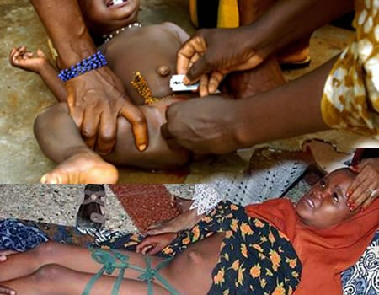
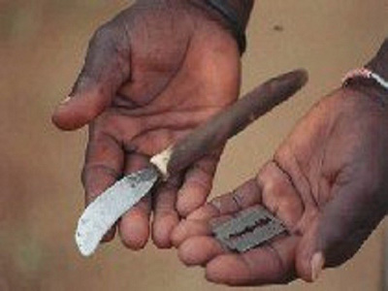

Slide 27
CRITICAL
Creates questions about cultural practices in terms of who is accepting them and why. Critical cultural relativism also recognizes power relationships.

Slide 28
Cultural relativism can be seen with the Chinese culture and their process of feet binding. Foot binding was to stop the growth of the foot and make them smaller. The process often began between four and seven years old. A ten foot bandage would be wrapped around the foot forcing the toes to go under the foot. It caused the big toe to be closer to the heel causing the foot to bow.In China, small feet were seen as beautiful and a symbol of status. The women wanted their feet to be “three-inch golden lotuses”三寸.
Notes:
It was also the only way to marry into money. Because men only wanted women with small feet, even after this practice was banned in 1912, women still continued to do it. To Western cultures the idea of feet binding might seems torturous, but for the Chinese culture it was a symbol of beauty that has been ingrained the culture for hundreds of years. The idea of beauty differs from culture to culture.

Slide 29
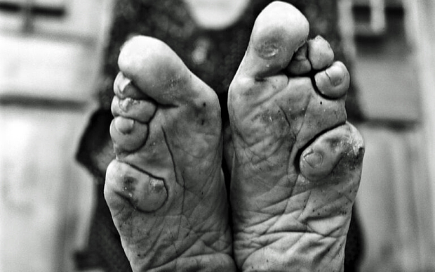

Slide 30
Appreciation of other cultures may come about for two complementary reasons:
Acquisition of sufficient knowledge about the culture in question
Direct exposure to other cultures

Slide 32
XENOCENTRISM
Preference for the foreign.
It is characterized by a strong belief that one’s own products, styles, or ideas are inferior to those which originate somewhere.

Slide 33
Xenophobia
It is the fear or dislike of people who are different from oneself, particularly foreigners. The term xenophobia originates from the Greek words xénos (stranger) and phóbos (fear), so it essentially means the fear of strangers; however, it is more often used to describe hatred or hostility.

Slide 34
Xenophobia comprises multiple aspects of prejudice and may be based on any racist, religious, ethnic, cultural or national discrimination.
Xenophobic attitudes and behaviors are often triggered by a fear that outsiders or foreigners are a threat to one’s community or national identity.
People with xenophobic attitudes often want to secure the perceived purity of their own culture or nation.
Notes:
For example, an American man who feels threatened or angry that his company has hired Russian interns would be considered xenophobic.

Slide 35
What is the cultural impact of xenocentrism in the Philippine culture?

